Slide 1
TREATMENT PLANNING FOR COMPLEX NEEDS: Integrating Mental Health, Physical Health and Substance Use Disorders
Substance Abuse Prevention and Control
County of Los Angeles Department of Public Health
UCLA ISAP Statewide Conference
October 25, 2018

Slide 2
Dr. Greg Schwarz, Psy.D. Dr. Alyssa Cohen, Psy.D. Los Angeles County Department of Public Health Substance Abuse Prevention and Control

Slide 3
Financial Disclosure
The presenters do not have any financial conflicts to disclose.

Slide 4
Objectives
At the conclusion of this training, you will be able to:
Utilize two methods to identify problem areas to formulate treatment goals.
Assess resistance in treatment and develop one strategy to re-engage patient in treatment.
Integrate specific cultural, linguistic and individual needs in the collaborative treatment planning process.
Construct S.M.A.R.T. goals to guide treatment, track progress and monitor outcomes.

Slide 5
Outline
Treatment Planning in Practice
Setting up the Collaboration
Re-Defining Resistance
Defining Areas of Treatment Focus
Developing S.M.A.R.T. Goals
Treatment Plan Review, Revisit, Revise
Summary
This Photo by Unknown Author is licensed under CC BY-SA
Notes:
Use example of TELLING, not collaborating, the audience what they are going to learn and do after presentation
Ask the audience for objectives
Keep in mind what the patient is really telling you, listen to the story.
Treatment planning as a story of the patient. Patient is the hero of the story, problem is the beginning, objectives are the middle along with action/interventions, outcomes are the ending.

Slide 6
What About Me?
Why are you attending this training and what information is beneficial to you?
What are your frustrations in the treatment planning process?
Notes:
Collaborative approach in action
Possible doctor appt example where doctor doesn’t listen
Referral question vs. what else is going on
Increases engagement and develops trust

Slide 7
TREATMENT PLANNING IN PRACTICE

Slide 8
Treatment Delivery: The Thomas Guide/GPS Version
What is the purpose of Treatment Planning?
“Care management is a set of activities intended to improve patient care and reduce the need for medical services by enhancing coordination of care, eliminate duplication, and helping patients and caregivers more effectively manage health conditions. These efforts have demonstrated potential to improve quality and control costs for patients with complex conditions.”
Goodell S., Bodenheimer TS, Berry-Millet R. (2009) Robert Wood Johnson Foundation, The Synthesis Report
How is Treatment Planning conducted?
Turning the concepts into a map to follow
Notes:
Treatment planning as the Thomas Guide/GPS of Care Management
Enlarge slides
Just like we had to learn how to read a map we need to learn how to navigate treatment with the patient

Slide 9
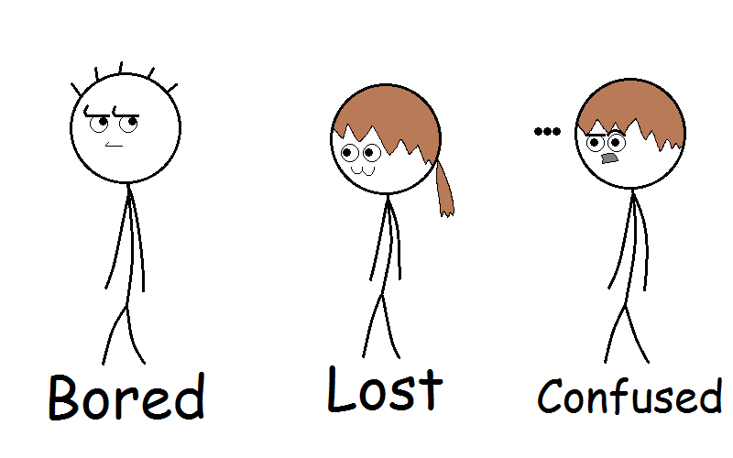
To Engage or Not Engage, that is the question?
“If you don't know where you are going, you'll end up someplace else.”
Yogi Berra

Slide 10
Treatment Planning IS…
Beneficial to all patient and providers:
Improves treatment outcomes
Improves client engagement
Collaborative & Shared
Based in communication with other providers
A way to map out the care in a tangible and easier to understand format
A constantly changing and dynamic process throughout the course of treatment
Challenging but…. NOT
This Photo by Unknown Author is licensed under CC BY
Notes:
Managed care usually dictates specific requirements and time frames- Required

Slide 11
Treatment Planning is NOT…
Only completed to avoid audit problems
Just Paperwork
The patient’s support system attempting to dictate treatment
Repeating the same goal for everyone who has the same condition
Permanent
One size fits all (Or No One)
Notes:
MD example. Not all diabetics are the same. Can’t give same medication to everyone who walks through the door
Think about removing

Slide 12
Simple & Complex Treatment Plans
What is a simple treatment plan?
Only one problem area
Only one objective
Patient dictates exactly what they need
Short term problem with known “cure”
What is a complex treatment plan?
Multiple health dimensions
Multiple objectives needed
Patient has difficulty explaining needs
Long term problems with multiple treatment options
Notes:
Ask audience
Who is coordinating the care, multiple coordinators- why we encourage all agency consent at SAPC
Who is on the Team?

Slide 13
SETTING UP COLLABORATION
This Photo by Unknown Author is licensed under CC BY-SA-NC

Slide 14
Patient Collaboration
Introduction and Informed Consent
- Patients need to understand the process of care and treatment planning before the plan is created.
- Will help with identifying specific goals and how to prioritize those goals.
Collaboration → Increased Participation
- Increased likelihood of engagement and follow through
- Vahdat et. al. (2014) comprehensive literature review
Notes:
Walk before you can run

Slide 15
Patient Collaboration cont’d
Patient Needs-Who knows more the Patient or Provider?
“It’s all about me”
Sometimes the provider has to help guide the patient to understand what available options exist
This is the collaboration in action
Patient wants the problem to disappear
Provider needs to educate and break it down into steps
Problems vs Goals vs Objectives
Notes:
Walk before you can run

Slide 16
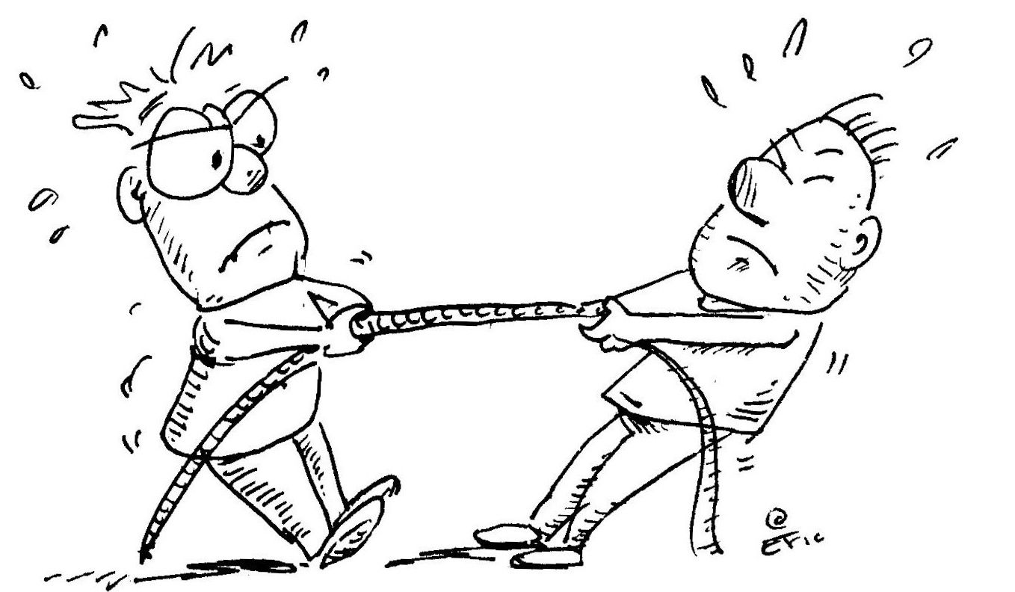
RE-DEFINING RESISTANCE
This Photo by Unknown Author is licensed under CC BY-SA-NC
Notes:
Non Compliance
Resistance is a difference in goals
Collaborative and integrating to combat resistance

Slide 17
What is Resistance?
Traditional definition
“More generally, however, the term is used to describe the direct or indirect OPPOSITION of a patient to the therapeutic process.”
Fournier, G. (2018). Resistance. Psych Central. Retrieved on August 13, 2018, from https://psychcentral.com/encyclopedia/resistance/
Client-Centered Definition
“Resistance is, in contrast, a relatively straightforward negative response to someone expecting you to do something that you do not want to do. The clinician can minimize resistance by understanding the client’s stage of change and being prepared to work with the client based on interventions geared to that stage.”
SAMHSA TIP 39, DHHS Publication No. (SMA) 05-4006 (2005)
Notes:
Therapeutic process is not just in terms of the therapy office. Any professional engaging a patient in treatment needs to have a therapeutic process, or understanding of the relationship with the patient.
Understand before moving into the full process will help alliance and with later goal development.
Resistance is when the patient and the provider have different goals.

Slide 18
Working With Resistance
Think of Resistance as a fork in the road, not a dead end.
- Move from Resistant to Engaging
Provider is responsible for identifying areas of resistance
- Results in Therapeutic re-aligning
- Engagement not just for therapists!
{Any treatment focused relationship is therapeutic in nature }
Change the focus of treatment to better match expectations of patient and provider.
Involve the patient more
Notes:
Therapeutic process is not just in terms of the therapy office. Any professional engaging a patient in treatment needs to have a therapeutic process, or understanding of the relationship with the patient.
Long term vs. short term goals
Imagine your physician involving you more in the treatment decisions. Here is your prescription vs. here are your options?

Slide 19
Patient Expectations
What does the patient expect from treatment?
Common misunderstandings
Patient role
Treatment modality
Provider role
Expected outcome
Definite Outcome or Maintenance
Certain illnesses/diagnoses have a cure, however others can only be maintained (an infection can be cured, depression cannot)
Having this understanding at the outset will improve treatment
Notes:
Therapeutic process is not just in terms of the therapy office. Any professional engaging a patient in treatment needs to have a therapeutic process, or understanding of the relationship with the patient.
Long term vs. short term goals

Slide 20
Provider Expectations
What does the provider expect from treatment?
Common misunderstandings
Patient role
Treatment modality
Provider role
Expected outcome
COMPLIANCE
Implies unidirectional relationship
Compliance and non-compliance imply lack of choice and collaboration.
Notes:
Therapeutic process is not just in terms of the therapy office. Any professional engaging a patient in treatment needs to have a therapeutic process, or understanding of the relationship with the patient.
Long term vs. short term goals
What do you think of when you hear “Compliance”

Slide 21
WHERE TO FIND THE INFORMATION
This Photo by Unknown Author is licensed under CC BY-NC-ND
Notes:
Assessment Information
Listen to Their Story
Comprehensive Treatment Plan
Prioritizing goals
Who knows the patient best, the provider or the patient?

Slide 22
Information Gathering
Collect data from all available sources to inform the treatment planning process
Assessment information
Historical
Current
Patient information
Observation
Patterns
Notes:
The middle of the story

Slide 23
Purpose of Assessment
Purpose of an assessment/screening is to provide information to guide treatment.
Clinical Interview
Can target both history and current concerns
Present focused questions
Past focused questions
Notes:
Can also be a way for patient to begin to think of the problem they want to focus on during treatment

Slide 24
Assessment Components
Primary source of information to guide treatment
Objective information
2 primary focuses of assessment
Historical symptoms
I.e. History part of H&P
Current symptoms
I.e. Physical part of H&P

Slide 25
Observational/Behavioral Assessment
Observation of the patient while answering questions (what they say and how they say it)
Use observational information or lab results to offer treatment suggestions
Patient states diet is good, but weight and A1C have increased
Patient states no problem with alcohol, but 2 DUI’s in 2 months
Patient states depression is stable, but released from hospital last week
Look for patterns in the history
How many relapses, E.D. visits, medication refills, social stressors etc…
Provider can “read between the lines” and ask about other needs.
Notes:
Use as talking points and possible goals to address

Slide 26
Cultural Factors
Notes:
Cultural graphic showed all things what goes into patient

Slide 27
Cultural Factors
Assessing for Cultural implications on treatment
Why is this important?
Does an individual’s culture change the approach to treatment?
Individual vs. collectivist culture
Family involvement
Direct or indirect communication
View of authority
Beliefs about treatment
Does culture change focus of objectives
Type of referrals (language, gender, ethnicity)
Who to involve in treatment
Acculturation
How do you assess for cultural factors?

Slide 28
Quick Stretch Break
Notes:
Stand up and stretch in our seats

Slide 29
DEVELOPING GOALS
Notes:
Miracle question

Slide 30
Knowledge vs. Action
Action is the other half!
Take information gathered from all available sources and transform into the treatment plan
Involves interpretation and translation

Slide 31
Problems, Goals & Objectives
Problem
Goal
Objective

Slide 32
Problems, Goals & Objectives
Problem: Reason the patient seeks treatment
What is the overall issue the patient wants to “fix”
“I’m Depressed”
”Chronic Back Pain”
“Addicted to drugs”
Goal: The broad direction of what needs to happen to achieve the desired outcome.
“Stop sleeping so much”
“Be able to go out more without being in so much pain”
“Stop using drugs”
Objective: More specific and detailed building blocks that make up a goal
Reduce hypersomnia (sleeping more than 9 hours) episodes from daily to 3x/week”
Experience pain level of no more than 5 out of 10 when engaging in activities
Report 50% reduction in cravings within 2 weeks of treatment

Slide 33
Comprehensive Planning
Presenting Problem
Desired Outcome
Realistic Outcome
Relevant History and Patterns
Current/Target Symptoms
Interventions
Comprehensive/Collaborative
Plan

Slide 34
The BioPsychoSocial Approach
Originally developed by George Engel, M.D.
Baby Monica
Became standard practice in Medicine and most other health fields
World Health Organization
Health is a state of complete physical, mental and social well-being and not merely the absence of disease or infirmity.
The enjoyment of the highest attainable standard of health is one of the fundamental rights of every human being without distinction of race, religion, political belief, economic or social condition.

Slide 35
The BioPsychoSocial Areas
ASAM Criteria
MultiDimensional Model
Substance Use, Acute Intoxication, Withdrawal (SUD)
Biomedical Conditions and Complications (Medical)
Emotional, Behavioral or Cognitive Conditions (Psychological)
Readiness To Change (Motivation)
Relapse, Continued Use or Continued Problem Potential (Behavioral)
Recovery/Living Environment (Social/Financial)

Slide 36
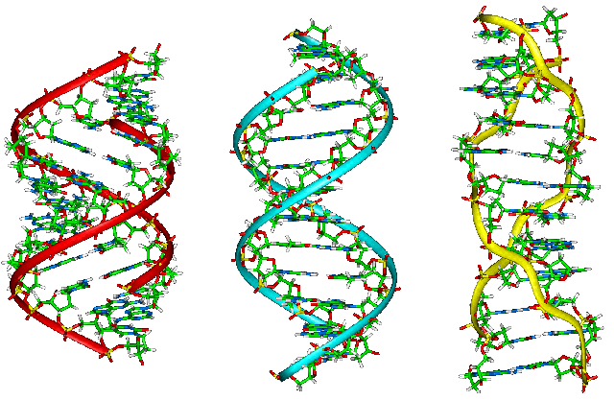
The “Bio”
Biological (Bio part)
Medical history
Surgeries
Diagnoses (past and present)
Current symptoms
Medications
Current
Past if on for extended period
Significant Hereditary concerns (I.E. Cancers, Dementias, Huntington’s disease)
Notes:
Why is this important for MH or SUD providers to know?

Slide 37
The “Psycho”
Psychological (Psycho part)
Mental Health history
Treatment episodes
Diagnoses (past and present)
Developmental
Trauma
Current symptoms
Past symptoms
Medications
Current
Past if on for extended period
Significant Hereditary concerns (Depression, Psychosis, Bipolar, Suicide)
Notes:
Why is this important for Medical providers to know

Slide 38
The “Social”
Social (Social part)
Family relationships
Parents
Siblings
Extended Family
Children
Living Environment
Type of Dwelling
Safety concerns
Who do they live with
Romantic Relationships
Sex
Love
intimacy
Friendships
Financial/Employment
Notes:
Why is this important for all providers to know?

Slide 39
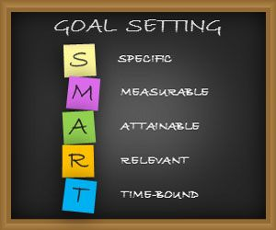
S.M.A.R.T. (M.A.T.R.S.) Goals
S.M.A.R.T. goals are efficacious and improve outcomes.
George T. Doran- November 1981 Management Review
M.A.T.R.S.- utilized by Addition Technology Transfer Center
Required format by some Managed Care (LACDMH, LAPH- SAPC, Joint Commissions Standards PC.4.10 and PC.4.40)
Specific
Measurable
Attainable
Realistic (AKA Relevant)
Time Related (AKA Time Limited)

Slide 40
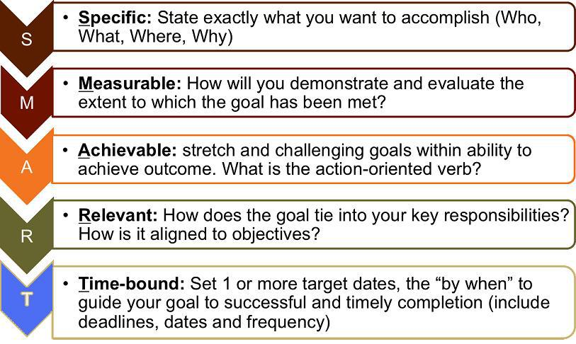
Notes:
M.A.T.R.S. from ATTC network handout

Slide 41
Examples of S.M.A.R.T. (M.A.T.R.S.) Goals
Patient’s depression (PROBLEM) will improve as seen by energy level increasing (GOAL), as evidenced by an increase in by exercise from 0 days/week from 3 days/week (OBJECTIVE)
Patient will reduce drinking alcohol (PROBLEM) from 7 days/week to 0 days/week (GOAL) as shown by daily breathalyzer tests and self-report (OBJECTIVE)
Patient will take medication as prescribed (GOAL) to reduce symptoms of high blood pressure (PROBLEM) from 0 days/day to 2 times/day, as shown by daily vital signs being within acceptable limits (OBJECTIVE).

Slide 42
S.M.A.R.T. (M.A.T.R.S.) Goals
Group activity
Situation: Patient admitted to SUD residential treatment program. You are the SUD counselor assigned to work the individual. After a full biopsychosocial assessment, the following problems emerge…
Problem 1: Addicted to Methamphetamines
Problem 2: Untreated Heart condition
Problem 3: In danger of becoming homeless
Problem 4: No Social support
Problem 5: Limited financial resources, Lost Medi-cal benefits
Problem 6: Long term untreated depression
Notes:
Where do you start?
What goals or objectives can you derive?
Priority?
Audience perspective based on primary work setting

Slide 44
TREATMENT PLAN REVIEW

Slide 45
Review of Progress, Goals, and Experience
Why is this important?
What should be reviewed?
Experience with the agreed upon activities, behaviors, or medications
Progress towards improvement in problem areas
Motivation to continue
How does the patient feel about the current treatment path?
Barriers to completing treatment plan

Slide 46
Review of Progress, Goals, and Experience
When should treatment & treatment plans be reviewed?
This depends on the treatment modality
The treatment environment will also dictate frequency
The specific goal/objective will indicate (I.e. if objective was to be completed in 1 month, treatment should be reviewed at least the end of that month)
At an agreed upon time period that is convenient and feasible for the patient

Slide 47
Updating Treatment Plan
Based on your review:
Were there any ‘resistance’ factors to problem solve?
Were the objectives too easy or too hard?
Any motivation issues to address?
What were the barriers?
What were the successes?
Previous objectives should be ended or closed if they are no longer relevant, with a date of completion, before new objectives are added
These can all be new objectives for the update, which may lead to better outcomes and increased patient engagement

Slide 48
This Photo by Unknown Author is licensed under CC BY-NC-ND

Slide 49
Summary
Research shows the best way to develop a treatment plan is to have a collaborative process between the patient and the provider.
Resistance is what happens when the collaboration or communication breaks down
Use all available information
Goals are S.M.A.R.T.
Information + Action = Effective Treatment plan
Don’t forget to check in with the patient
Notes:
Patient is the story teller and you are the biographer.

Slide 50
This Photo by Unknown Author is licensed under CC BY-NC-ND

Slide 51
This Photo by Unknown Author is licensed under CC BY-NC-ND
Notes:
Leave sufficient time for questions (may not need to have primer questions due to time constraint)

Slide 52
Notes:
Handout evaluation

Slide 53
Dr. Greg Schwarz, PsyD gschwarz@ph.lacounty.gov 626-299-3528 Dr. Alyssa Cohen, PsyD acohen@ph.lacounty.gov 626-299-3534
Contact Us

